Slide 2
Deep Learning at Scale With Azure Batch
Mathew Salvaris
Thomas Delteil
Fred Park
Alex Sutton

Slide 3
Session Goals
Learn Azure Batch concepts as applied to deep learning workflows
Use Azure Batch to train and score deep learning models on a GPU cluster with Batch Shipyard and example Notebooks
See examples of Batch Shipyard with different scenarios, deep learning frameworks, and node configurations
Notes:
This slide is required. Do NOT delete. This should be the first slide after your Title Slide.
This slide should describe what your goals are for this session. This information lets your audience know what you are trying to accomplish with your talk or tutorial—ie, what value will attendees get by investing 25 minutes or 2 hours of their time listening to you.
You should not spend more than 1 minute presenting this slide.
General examples of session goals could be (you will have to create your own specific goals):
Introduce a new technique or approach to solve a customer problem
Compare two approaches and explain why one is superior
Describe a project and the learnings that audience members can apply from it
Teach audience members how to use a specific technology

Slide 4
Agenda
Run Setup Notebook
Azure Batch and Batch Shipyard Overview
GPU Training, Scoring and Parameter Sweep Notebooks
Optional Notebooks
Ask questions, share feedback and ideas

Slide 5
Step 1: Run Setup Notebook

Slide 6
Getting Started
Start at https://notebooks.azure.com
Login or create an account
Browse to the following link and click the “Clone” button
https://aka.ms/deep-learning-at-scale
Open the first notebook (01_Setup.ipynb) in your library and follow the instructions with your Azure Pass subscription

Slide 7
Azure Batch Overview

Slide 8
Azure Batch
Cloud-scale job scheduling
On-Demand compute clusters
Managed task execution
Tell us what command line to run, where to run it, and how many in parallel
Cost effective: pay for the compute resources you use
https://azure.microsoft.com/services/batch/

Slide 9
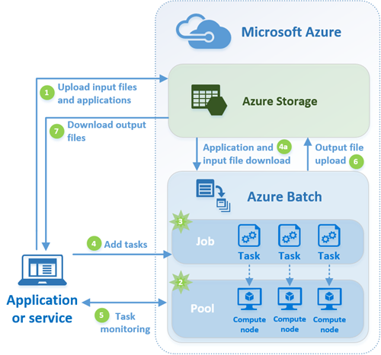
Azure Batch Concepts
Azure Subscription
Batch Account
In a region and resource group
Compute Pool
Compute Nodes
Job
Tasks
https://docs.microsoft.com/azure/batch/batch-technical-overview

Slide 10
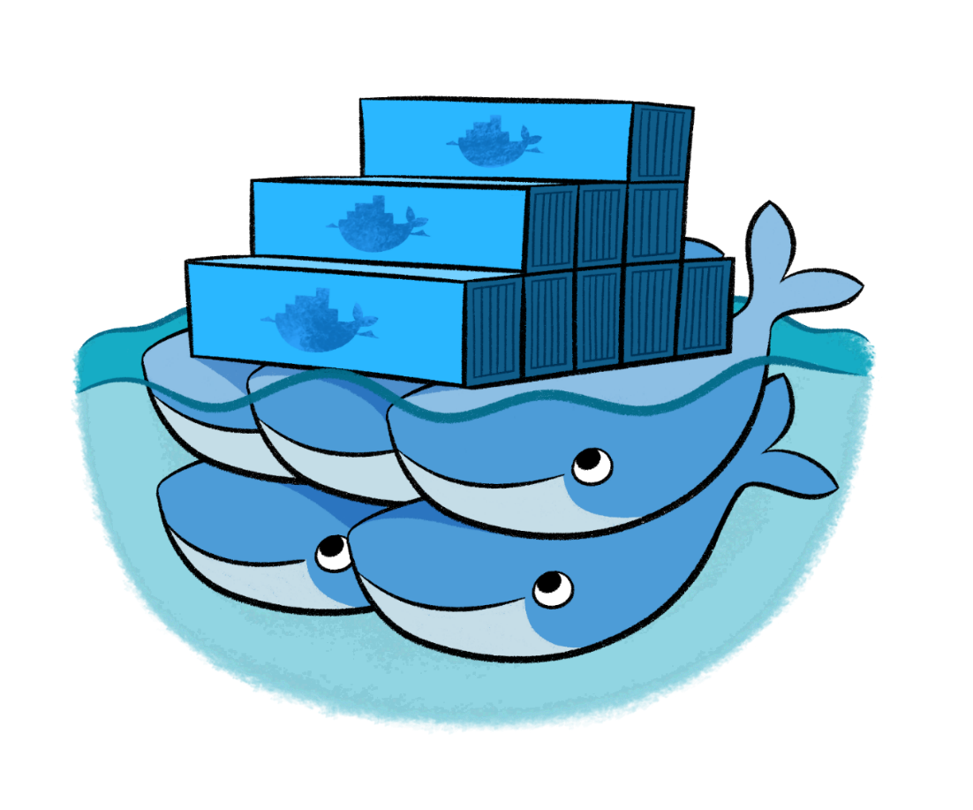
Batch Shipyard
Tool to help provision and execute batch processing, HPC, and AI Docker workloads on Azure Batch compute pools
Run Dockerized tasks with simple configuration files
Built on Python
Open source community project
Get ideas out for feedback and to unblock customers
Features may move into Batch Service and SDK
https://github.com/Azure/batch-shipyard

Slide 11
Major Batch Shipyard Features
Docker Host Engine installation tuned for Azure Batch and images deployed to nodes with support for private registries, including Azure Container Registry
Data movement for jobs between locally accessible storage systems, remote filesystems, Azure Blob or File Storage, and compute nodes
Standalone remote filesystem provisioning and auto-linking these filesystems to compute nodes with support for NFS and GlusterFS distributed network file systems
Full pass-through of the Batch API to Docker containers executed on compute nodes allowing complex processing pipelines and DAGs
Transparent support for GPU and InfiniBand/RDMA to Docker containers with automatic setup
Multi-instance tasks for Dockerized MPI and multi-node cluster applications with automatic job completion and Docker task termination
Automatic setup of SSH users to all nodes and optional tunneling to Docker hosts
Azure Function App integration and support as an execution target for triggers

Slide 12










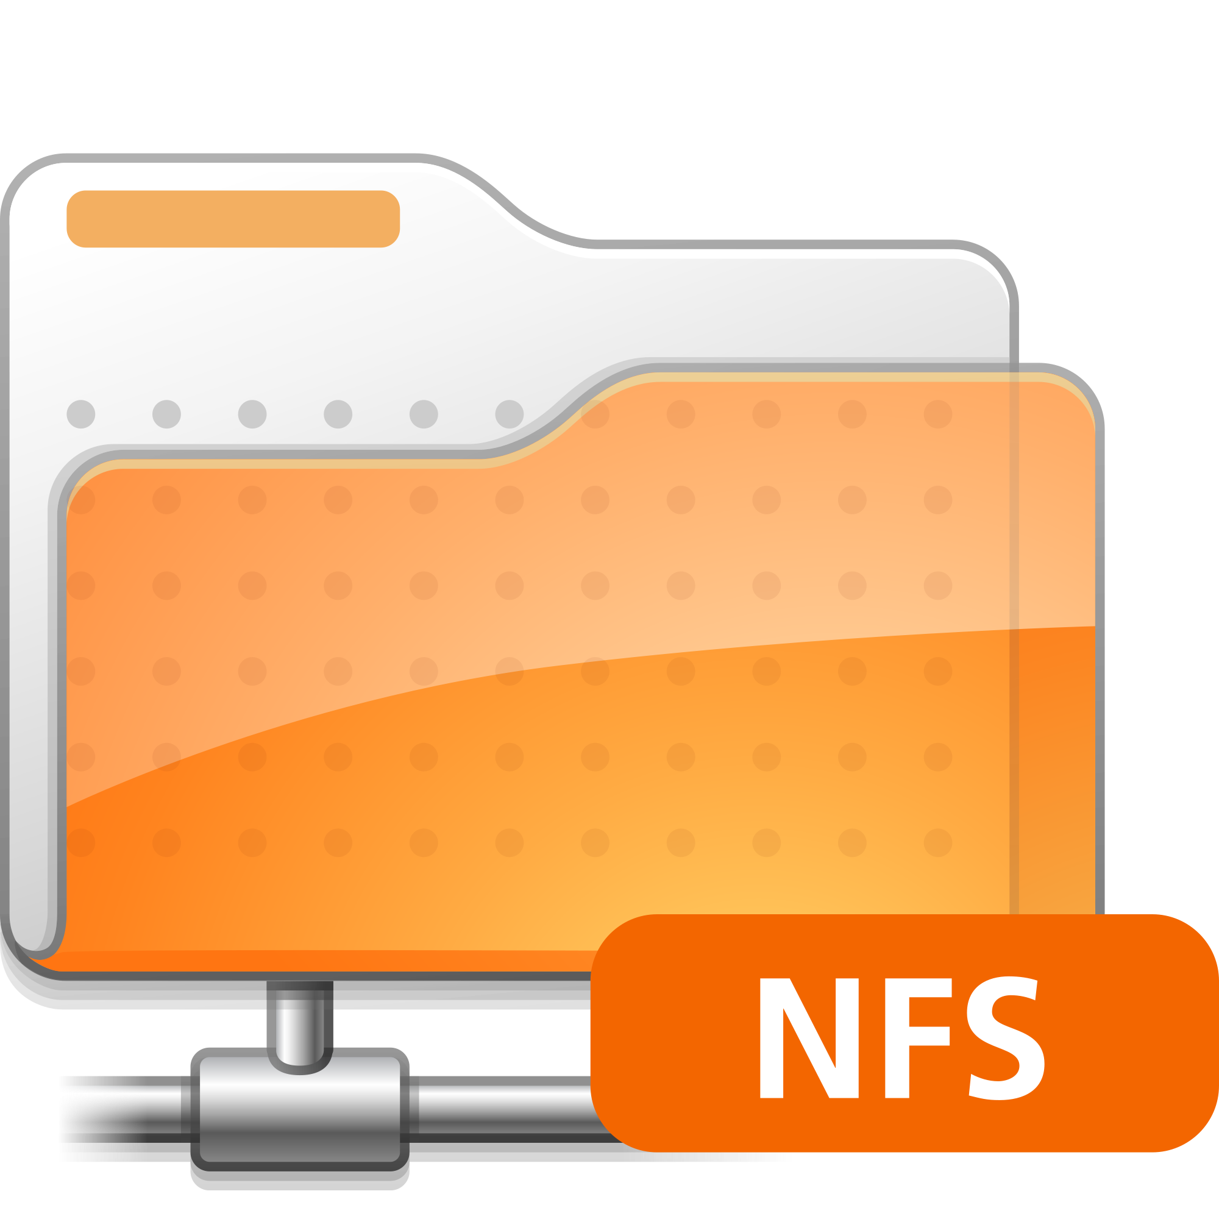


Batch Shipyard: Accelerating AI Batch Workloads
Batch Shipyard Compute Node
Allocate
Resources
Schedule
Jobs
Batch Shipyard Compute Pool
Azure Batch Service
Azure Batch Pool
Simplify
Enhance
Batch Shipyard CLI
Batch Shipyard RemoteFS
Automate

Slide 13



DNN Training Example Workflow with ABS
Create a DNN training script with any chosen tool
Package the DNN as a Docker image and upload it to the Azure Container Registry
Create a pool with GPU VMs
Schedule job for parameters sweep training tasks on the pool
Tasks are allocated to the pool and the Docker image is downloaded if required
Data is copied to the container
Tasks as containers perform the DNN training
Tasks write results and trained models to storage
3
4
7
1
5
2
DSVM
6
8

Slide 14
Using Batch Shipyard (aka the Tutorial)
Run the install script or pull the Docker image
Set up Batch and Storage accounts
Configure 4 JSON files
credentials.json
config.json
pool.json
jobs.json
Python command line
pool add, jobs add
Can start with a recipe

Slide 15
Step 2: Single GPU Training, Scoring, Parameter Sweep, Advanced Scenarios, and Cleanup

Slide 16
Ask Us Questions Share Ideas and Feedback

Slide 18
Example DNN Training Workflow
Create DNN training Docker image and upload to Azure Container Registry
Create a Batch pool with GPUs
Add a job with training tasks to run a hyper-parameter sweep experiment
Tasks are scheduled to the pool and the Docker image is loaded if needed
Tasks read training data from storage
Tasks perform the DNN training
Output and models written to storage
DSVM

